Slide 1
SY 2022-2023 Fall Block NJSLA Analysis
Sending School Superintendent Meeting
Impact on Student Placement
February 22, 2023

Slide 2
Current Placement Practice (Grade 9)
Current Levels
Honors
College Prep A
College Prep B
Resource
Placement is based on 3 pieces of data:
8th Grade Benchmark results (January LinkIt B benchmark administration) - administered by the sending schools
8th Grade Teacher Recommendation
8th Grade Course Grade

Slide 3
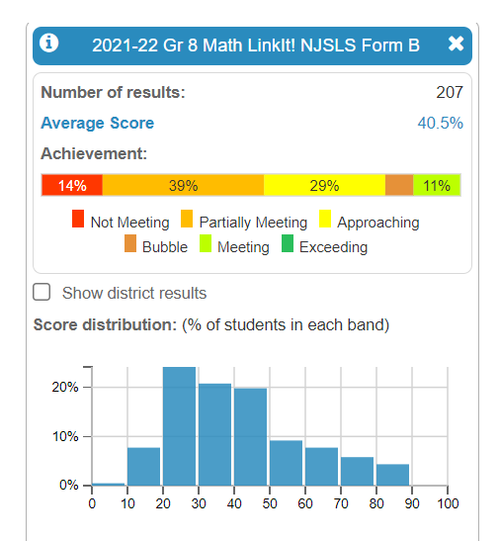
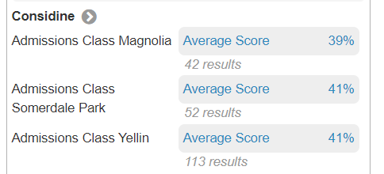
11% of all 8th grade students - Project “Meeting” on 8th grade NJSLA
7% of all 8th grade students-Project “Bubble” on 8th grade NJSLA
Data includes all 8th grade students from sending schools (including 8th grade students taking Algebra I and 8th graders who may not attend Sterling)
Cut Score Correlations

Slide 4
2022-2023 NJSLA Algebra 1 Results (Fall Block)
Based on 37 CPA test takers:
0%: Exceeding Expectations
3%: Meeting Expectations ( 1 student)
43%: Approaching Expectations (16 students)
46%: Partially Meeting Expectations (17 students)
3%: Did Not Meet Expectations (1 student)
2 students did not take the exam

Slide 5
Students Taking Algebra I in 8th Grade
School (# of students in Alg. 1) | % of Students Level 4+5
Magnolia (12) | 66.7%
Somerdale (16) | 37.5%
Yellin (30) | 70%
11 9th grade students enrolled in S1 Geometry after completing Algebra I in 8th grade
Of those 11, we received Algebra NJSLA results for 9 of them - all of the students scored “Approaching” or lower on the Algebra I NJSLA
Of those 11, none of those students scored above “Approaching” on the Geometry NJSLA

Slide 6
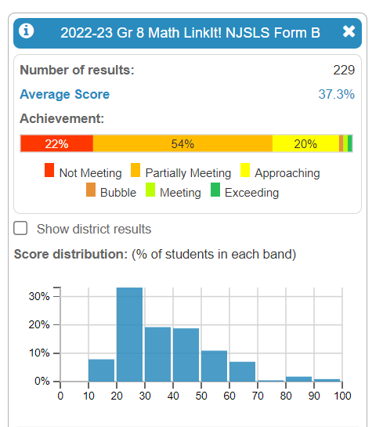

Slide 7
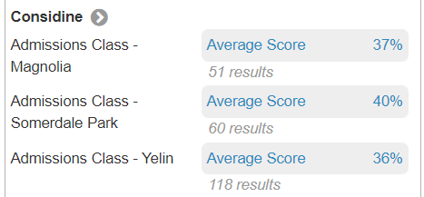
Results by school ‘21-’22
Results by school ‘22-’23

Slide 8
Recommendations
Full Year Mathematics courses for all 9th grade Algebra I students
Hire an additional Math Teacher
Implementation of an intervention program within the 80-minute block to support lack of pre-requisite skill knowledge
Possible summer math intervention and/or enrichment program (for interested students?)
Requirement that students who complete Algebra I in 8th grade MUST achieve a score of “Meeting” or “Exceeding” on the NJSLA to place into Geometry in 9th grade
Students who do not score high enough on the NJSLA can choose to take the LinkIt benchmark at Sterling in the summer. A score of “Meeting” or “Exceeding” will place them into Geometry
Students who place into Geometry must also complete an Algebra review packet in the summer before beginning Geometry.

Slide 9
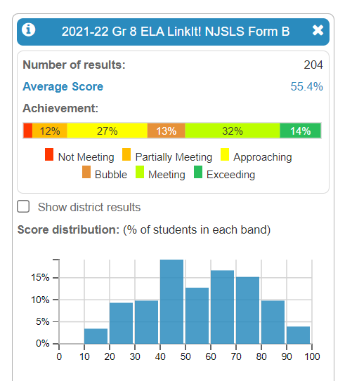
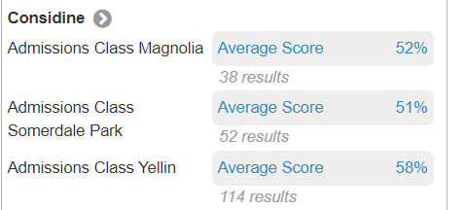
14% of all 8th grade students project “Exceeding” on the 8th grade NJSLA
32% of all 8th grade students project “Meeting” on the 8th grade NJSLA
13% of all 8th grade students project “Bubble” on the 8th grade NJSLA
Cut score correlations

Slide 10
English
80 Students in Grade 9 English in S1:
43 in CPA (2 sections)
15 in CPB (2 sections)
22 in Honors (1 section)

Slide 11
2022-2023 NJSLA English 1 Results (Fall Block)
Based on 80 test takers in H (22 students), CPA (43 students), CPB (15 students) levels:
5%: Exceeding Expectations (4 students)
37.5%: Meet Expectations (30 students)
17.5%: Approaching Expectations: (14 students)
24%: Partially Meeting Expectations (19 students)
14%: Did Not Meet Expectations (11 students)
2 students Did Not Test

Slide 12
Recommendations
Current practice: students entering 9th grade are placed into classes using 3 pieces of data
LinkIt benchmark
Teacher recommendation (8th grade)
Current 8th grade Course grade (recommendations made in January)
Based on S1 NJSLA results, conversations with teachers and counselors, we are concerned that there is not enough data to appropriately place students in leveled classes.
S1 NJSLA data shows that with the exception of the Honors students, students in CPA or CPB do not perform considerably different and/or grow based on the level of their classes.
Recommendation: 1 level of CP for all 9th grade students/classes for SY 2023-2024 with the exception of Honors students. Students take a separate exam and must score at a specific level in order to be placed in the honors class (as opposed to a relative score currently used)
At the completion of the 9th grade year students will have at least 6 pieces of data with which to make leveling decisions:
2-3 LinkIt benchmarks (ELA and Math) - as well as 8th grade prior data
8th and 9th grade NJSLA data
9th grade course grades and teacher recommendations

