Slide 1



Sterling regional high school district board of education Summer RETREAT
ALICIA D’ANELLA, ESQ.

Slide 2
Back to the Beginning: 2002-2008
2002
First version of HIB statute adopted.
2007
Amended to include recognition of cyber bullying.
2008
Required boards to post HIB policy on website.

Slide 3
HIB 2.0: The 2010 Amendments
2009 report from New Jersey Commission on Bullying:
32% of students 12-18 were bullied in previous year.
25% of schools identified bullying as a daily/weekly problem.
Percentage of NJ students being bullied is 1% point higher.
In 2010 bullying led to student suicide.
Research has emerged since 2002 enactment and 2007 and 2008 amendments.
Districts, students, parents, teachers, boards would benefit from clearer standards on what constitutes HIB, and how to report, investigate and respond.

Slide 4
HIB 2.0: The 2010 Amendments (cont’d)
2009 report from New Jersey Commission on Bullying:
Legislature intends to strengthen standards and procedures.
Fiscal responsibility requires this approach to better use existing resources to keep students safe.
Existing school personnel should be utilized.
Strengthening standards will help reduce the risk of suicide.
HIB is also a problem at institutes of higher education, which also must include these prohibitions in their code of conduct.
Bill introduced 11/8/10, passed house 11/15/10, senate 11/22/10, signed by Governor 1/5/11. Theories?

Slide 5
HIB 2.0: The 2010 Amendments (cont’d)
2010 Amendments:
Amends definition of HIB to provide for “substantial disruption or interference of orderly operation” and hostile education environment.
Bias/intimidation crimes as disqualifying offense.
Requires HIB and suicide prevention training for staff, administrators and board members.
REQUIRES (rather than encourages) bullying prevention programs.
Requires districts to respond to incidents that occur “off school grounds.”

Slide 6
HIB 2.0: The 2010 Amendments (cont’d)
2010 Amendments:
Requires creation of school safety team, district ABC, building ABS.
Requires twice annual report to board instead of annual.
Created requirement of “week of respect.”
Provides for discipline for school administrators who fail to initiate or conduct investigations when required.
Includes HIB as conduct that may constituted good cause for suspension or expulsion.

Slide 7
HIB 2.0: The 2010 Amendments (cont’d)
What are the prevailing themes?
Training for staff
Instruction for students
Preventative measures
Broadening definitions
Transparency
What are we not seeing?
Disciplinary consequences
Demonizing bullies

Slide 8
HIB: Recurring Theme
Impact on Victim is paramount
Why?
…intended to help victims and remediate bullying behavior rather than just punish offenders

Slide 9
HIB 3.0: The 2022 Amendments
HIB 3.0?
Imposes civil liability on parents of offenders whose kids are adjudicated delinquent of cyber harassment as well as fines for parents/guardians who fail to comply with any condition of adjudication.
Creates a “record” for offenders:
1st and 2nd offense: Results of investigation placed in student record.
3rd offense: Results placed in record, individual student intervention plan developed by principal and staff and approved by superintendent, may require student (accompanied by parent or guardian) to complete class/program to reduce HIB behavior.
Principal must keep written record of initial notification to parents
DOE guidance for parents to be posted on homepage/338 form

Slide 10
HIB: Issues
Parents of aggressors think a substantiated HIB is a scarlet H.
Focus on perceived long-term consequences instead of embracing the learning lesson.
Misses the point and creates distrust and resentment.
Parents of targets think a substantiated HIB leads to greater discipline or more serious consequences.
School is where we give kids the space to mess up and learn.
Misses the point and creates distrust and resentment.

Slide 11
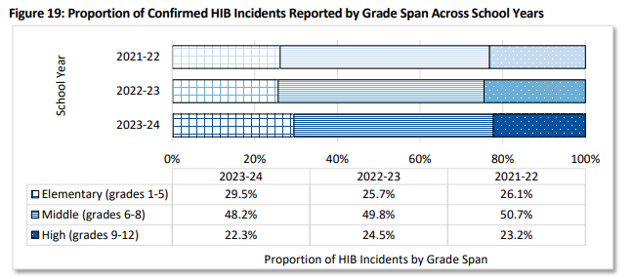
HIB by Grade Span

Slide 12
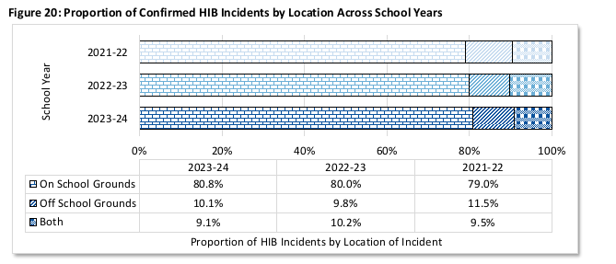
HIB by Location

Slide 13
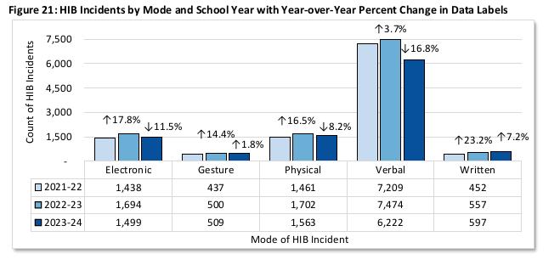
HIB by Category

Slide 14
HIB Today: Nuts and Bolts
HIB DEFINITION:
Any gesture, written, verbal or physical act, or electronic communication, whether a single incident or series of incidents That takes place on school property, at any school-sponsored function, on a school bus or off school grounds
AND
That is reasonably perceived as being motivated either by any actual or perceived characteristic, such as race, color, religion, ancestry, national origin, gender, sexual orientation, gender identity and expression or a mental, physical or sensory disability, or by any other distinguishing characteristic;
AND
That substantially disrupts or interferes with the orderly operation of the school or the rights of other students and that
AND that:

Slide 15
HIB Today: Nuts and Bolts
PICK ONE:
A reasonable person should know, under the circumstances, will have the effect of physically or emotionally harming a student or damaging the student's property, or placing a student in reasonable fear of physical or emotional harm to his person or damage to his property;
OR
Has the effect of insulting or demeaning any student or group of students;
OR
Creates a hostile educational environment for the student by interfering with a student's education or by severely or pervasively causing physical or emotional harm to the student.

Slide 16
HIB Today: Procedure
School Day 1 (HIB occurs or we learn of HIB)
Verbal Report to Principal*
Principal must inform parents/guardians AND KEEP WRITTEN RECORD OF DATE, TIME AND MANNER OF NOTIFICATION
School Day 2
Principal must initiate investigation by ABS within one school day
School Day 3
Written report to Principal within 2 days of witness/learning
School Day 3-13
Investigation must be complete within 10 days of written report
School Day 13-15
Results of investigation go to Superintendent within 2 days of completion; may take action (intervention, services, discipline, etc.)

Slide 17
HIB Today: Procedure
Superintendent reports results to Board:
At the next board meeting following completion of investigation (first reading)
Information only
Parents are notified of outcome:
Within 5 school days of report to board, parents are notified of the outcome, and are entitled to receive information regarding the nature of the investigation, whether discipline was imposed or services provided
Parents may request a hearing within 60 days of receiving this information
Board’s Role:
At the next meeting following receipt of report (second reading):
board shall issue a decision to affirm, reject or modify the Superintendent’s recommendation

Slide 18
HIB Today: Board Appeal
Board Hearing:
Must be held within ten days of request
Occurs in executive session or by committee
Board may hear from school ABS, discipline or service recommendations, any programs intended to reduce incidents
Not an adversarial proceeding
Parents can appeal to Commissioner within 90 days of final determination
Final Thoughts:
Trust the person in the room
Don’t second guess
Acknowledge the frustration

Slide 19
Harassment, Intimidation and Bullying Greatest Hits

Slide 20
What happens when an HIB appeal is filed?
Parent appeals to Board. Board issue final decision.
Parent appeals to Commissioner of Education
(w/in 90 days)
Commissioner sends case to Office of Administrative Law
Administrative Law Judge presides over a fact-finding hearing
Administrative Law Judge issues
“Initial Decision”
(Arbitrary, Capricious and Unreasonable)
Commissioner issues
“Final Decision”
(Arbitrary, Capricious and Unreasonable)

Slide 21
Substantial Disruption
D.K. v. Readington BOE
Students on the school bus allegedly referred to the AV (7th grade) as a “know it all”, “smarty pants”, and a “dumb ass Asian”. While in homeroom, a student told the alleged victim, who was wearing a yellow shirt, that “you’re already yellow, you’re Asian.”
Conclusion: NOT HIB
“Smarty pants” and “dumb ass Asian” were not corroborated
“Know it all” was not based on distinguishing characteristic
Comment about student’s race and color did not cause substantial disruption
Agree or Disagree?
AV said: although the comment may have “ticked him off” at the time, it “was not problematic for my learning experience.”
Commissioner AFFIRMED

Slide 22
Substantial Disruption
W.D. o/b/o J.D. v. Jefferson Township BOE:
A group of 5th grade girls on a group text thread were pretend fighting. The pretend fighting included calling each other many inappropriate names. It ended when one of the girls used the “n” word toward the AV, who is black.
Conclusion: NOT HIB
AO’s actions were precipitated by the mutual pretend fighting, which AV was also engaging in.
AV was her normal self in class after the incident. Did not affect grades or attendance.
Despite a few initial awkward moments in the following days, within a few weeks, the girls wanted to work on group projects together again.

Slide 23
Substantial Disruption
W.D. o/b/o J.D. v. Jefferson Township BOE:
On Appeal
ALJ agreed this was not HIB. Recognized the use of the N word is “abhorrent and cannot be tolerated” but agreed that it was precipitated by conduct that the girls were all mutually engaging in and that there was no evidence of substantial disruption.
Commissioner agreed with ALJ
On HIGHER Appeal:
“This court does not take lightly J.D.'s use of the N-word toward G.D., especially considering the greater historical context of white people using the N-word against black people for the purpose of classifying and stigmatizing black people as inferior to whites… Even so, a full review of the record supports the Commissioner's conclusion – the incident in question was a conflict… All the students… appear to have been fully involved in the pretend prank fight…Furthermore, the record does not establish …any significant impact beyond being rightfully upset following the incident and wanting to avoid resulting awkwardness at school the next day…”

Slide 24
HIB: Impact versus Intent
L.K. and T.K o/b/o A.K. v. Mansfield Board of Education
AO and AV were both 7 years old. AO knew AV to be a boy. During the new school year, AV began wearing dresses and had his ears pierced. AO told AV he could not wear a dress because he was a boy and referenced other things he could not “like” because he is a boy. Staff spoke with the AO and counseled against future behavior. The next day, a subsequent incident occurred. The AV was upset by the AO’s conduct and no longer wanted to ride the bus with her. AV’s parents began driving him to school.
Conclusion: HIB substantiated
Board staff relied heavily on the fact that the behavior continued the next day
On Appeal (ALJ): REVERSED
ALJ reversed, finding that there was no evidence that the AO’s conduct was motivated by anything but curiosity.
On Appeal (Commissioner): AGREED WITH BOARD
Commissioner rejected ALJ’s decisions saying motive did not need to be considered

Slide 25
HIB: Impact versus Intent
S.C. o/b/o K.C v. Montgomery BOE
AO was concerned her friend had an eating disorder. AO admitted making comments to AV about the fact that AO felt she was anorexic because her eating habits had changed. AO also admitted taking AV’s iPod to text AV’s boyfriend about the issue. AV stated she felt hurt by her friends and cried in the bathroom.
Conclusion: HIB substantiated
Board staff noted that they believed the AO had good intentions but simply went too far.
On Appeal (ALJ): AFFIRMED
When there is room for two opinions, the actions of the Board cannot be seen as arbitrary even if the court would have reached a different conclusion.
Commissioner agreed with ALJ’s decision.

Slide 26

HIB: Distinguishing Characteristic
L.R. v. Paramus BOE
AO texted AV a picture of AV and Stewie Griffin and said “What do you call someone with a big head?” AV was sufficiently upset to skip school for several days and then needed a schedule change.
Conclusion: Affirmed HIB
District found that forehead size was the distinguishing characteristic
On Appeal: ALJ affirmed
Parent raised no meaningful argument other than arguing the law is too broad.
Commissioner AGREED and upheld the HIB.

Slide 27
HIB: Distinguishing Characteristic
J.M. v. School District of the Chathams BOE
AO offered AV a cashew. AV was known to have a nut allergy. AO then touched AV’s water bottle and lunch bag.
Conclusion: Affirmed HIB
District found that the conduct was motivated by AV’s nut allergy and the AO’s conduct compromised his safety.
On Appeal (ALJ): REVERSED
ALJ found that the Board overreacted, the AV’s parent did not seek a harsh penalty, and there was no pattern of conduct.
ALJ also found that a HIB finding is too harsh and having an HIB on his record could be detrimental to him.
On Appeal (Commissioner): AGREED WITH BOARD
Commission said the ALJ’s rationale was based on irrelevant considerations.
Affirmed that allergy is a distinguishing characteristic, that the threat to AV’s safety was a substantial impact, and that based on the AO’s knowledge of the AV’s allergy, it was reasonable to assume he knew that his conduct would cause AV to fear for their safety.

Slide 28
HIB: Investigation Reports
Shim v. Ridgefield BOE
Teacher took a picture of a student’s head/hairstyle when the student was bending down to tie his shoe. Teacher showed the picture to the student and said they could play tic-tac-toe on his head because his head looked like a tic-tac-toe board.
Conclusion: Affirmed HIB
District found that the conduct was motivated by race.
On Appeal (ALJ): REVERSED
ALJ found that the report was inadequate and failed to address substantial impact. Report said the student “looked puzzled, maybe in shock.”
On Appeal (Commissioner): AGREED WITH ALJ
Commissioner did not “condone petitioner’s conduct and poor judgment” but agreed that the investigation failed to address all aspects of the statute.

Slide 29

Questions?
Alicia D’Anella, Esq.
adanella@gdmlawgroup.com

